Slide 1
CHAP V: MS OFFICE TOOLS
PART 1 :MICROSOFT WORD

Slide 2
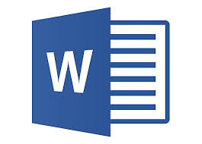
What is Microsoft Word?
Microsoft Word, also referred to as simply Word, is a word processor developed by Microsoft. It was first released on October 25, 1983 under the name Multi-Tool Word for Xenix systems.- “Wikipedia”
Original author: Microsoft Corporation
Programming language: C++

Slide 3
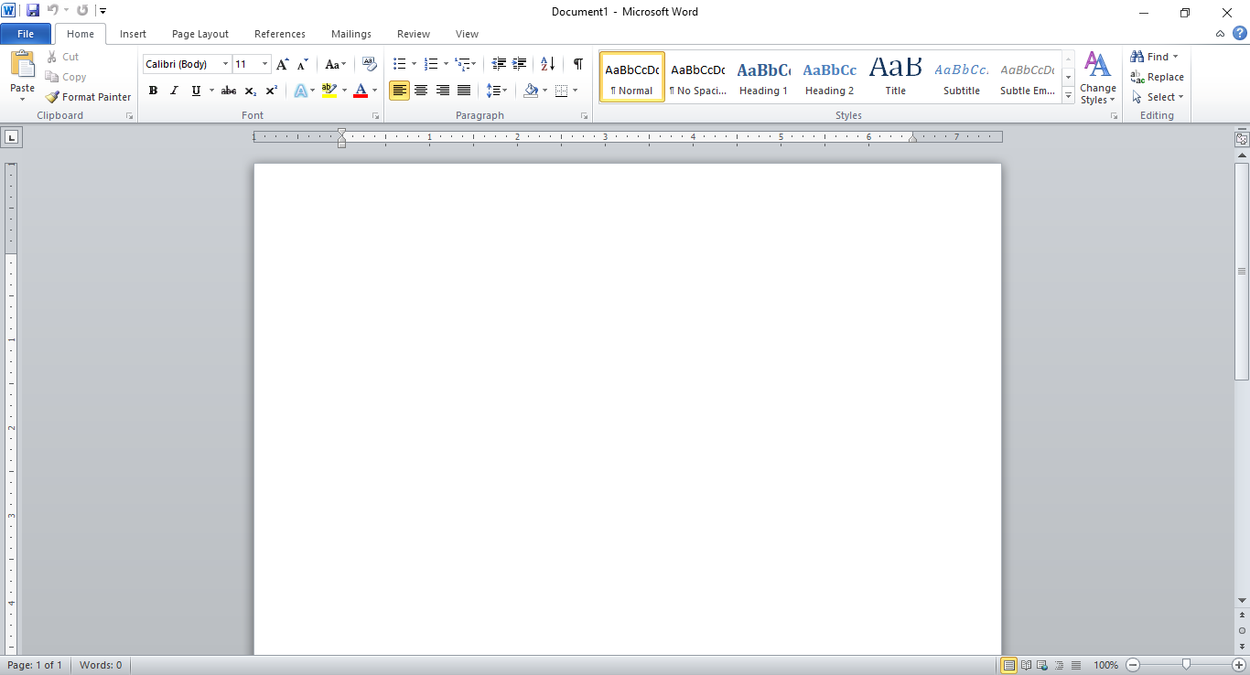
MS Word Layout

Slide 4
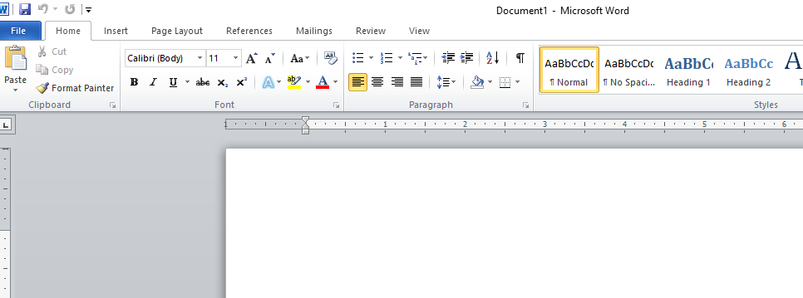
LAYOUT- Quick Access Toolbar, Title Bar, Tabs, Ribbon, Dialog Box Launcher, Group, Ruler
Quick Access toolbar
Title Bar
Tabs
Group
Dialog Box Launcher
Ribbon
Ruler

Slide 5
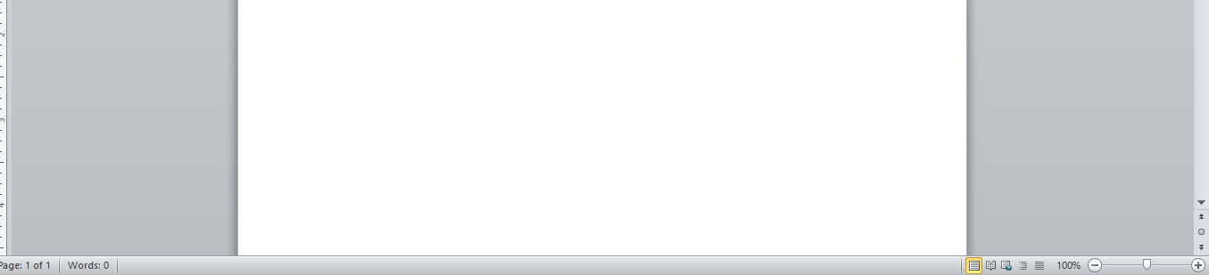
LAYOUT-Document Area, Zoom Control, View Button and Status Bar
Document Area
Status Bar
Zoom Control
View Button

Slide 6
MS WORLD BASICS
Getting started
Explore Window
Backstage view
Entering Text
Move around the document
Closing a document
Context Help

Slide 7
EDITING DOCUMENTS
Insert Text
Select Text
Delete Text
Move Text
Copy & Paste
Find & Replace
Spell Check
Zoom in out
Special Symbols
Undo Changes

Slide 8
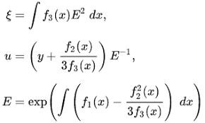
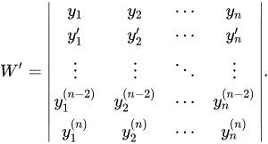
EXERCISES

Slide 9
FORMATTING TEXT
Setting Text Fonts
Text Decoration
Change Text Case
Change Text Color
Text Alignments
Indent Paragraphs
Create Bullets
Set Line Spacing
Border and Shades
Set Tabs
Apply Formatting

Slide 10
FORMATTING PAGES
Adjust Page Margins
Header and Footer
Page Numbers
Insert Page Breaks
Insert Blank Page
Cover page

Slide 11
WORKING WITH TABLES
Create Table
Rows & Columns
Move a Table
Resize a Table
Merging Cells
Split a Table
Split Cells
Add Formula
Border & Shades

Slide 12
ADVANCED OPERATIONS
Quick Styles
Use Templates
Use Graphics
Auto Correction
Auto Formatting
Table of Contents
Preview Documents
Printing Documents
Email Documents
Document Security
Set Watermark

